Slide 1

International institute of professional studies,DAVV INDORE
SDD OF Online Student Registration System
Submitted by :-
Vikas Kaushal
Roll_No.: IT-2K19-71
MTECH-IT

Slide 2
System Design Discription of Online Student Registration System:
The purpose of System Design is to create a technical solution. That satisfies for the functional requirements for the System. A software design description (a.k.a. software design document or SDD; just design document; also Software Design Specification) is a representation of a software design that is to be used for recording design information, addressing various design concerns, and communicating that information to the design’s stakeholders.

Slide 3
Database Design
The general theme behind a database is to handle information as an integrated whole. A database is a collection of irrelated data stored with minimum redundancy to serve many users quickly and efficiently. The general objective is to make information access easy quick and flexible for users .In database design serveral objectives are considered.

Slide 4
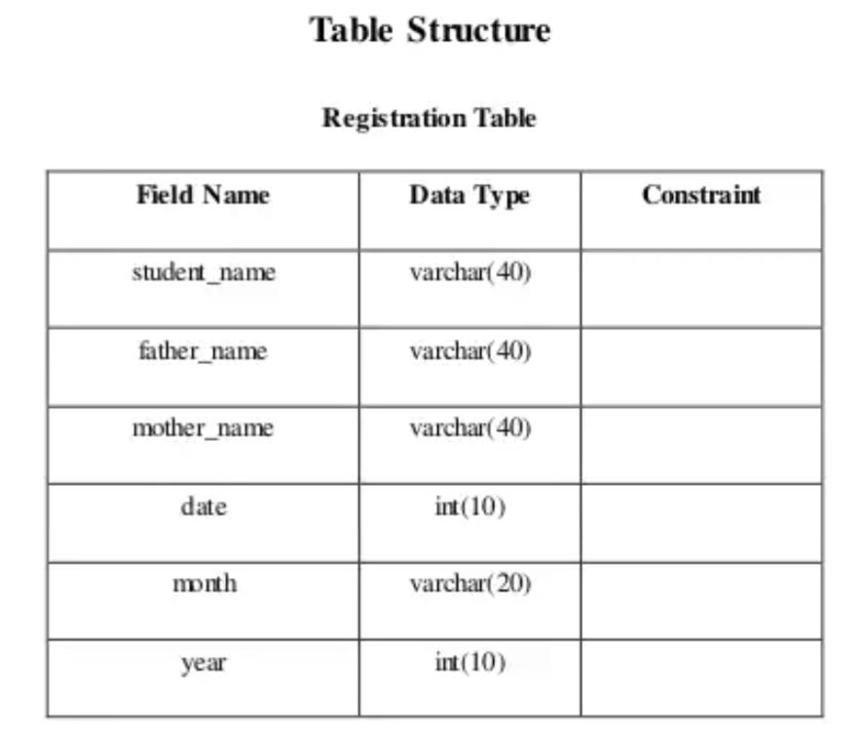
Control Redundancy
Redundant occupies space and therefore is wasteful . If versions of the data are in different phases of updating the system often gives conflicting information. A unique aspect of database design is storing only ones, which controls redundancy and improves system performance.
Registration Table

Slide 5
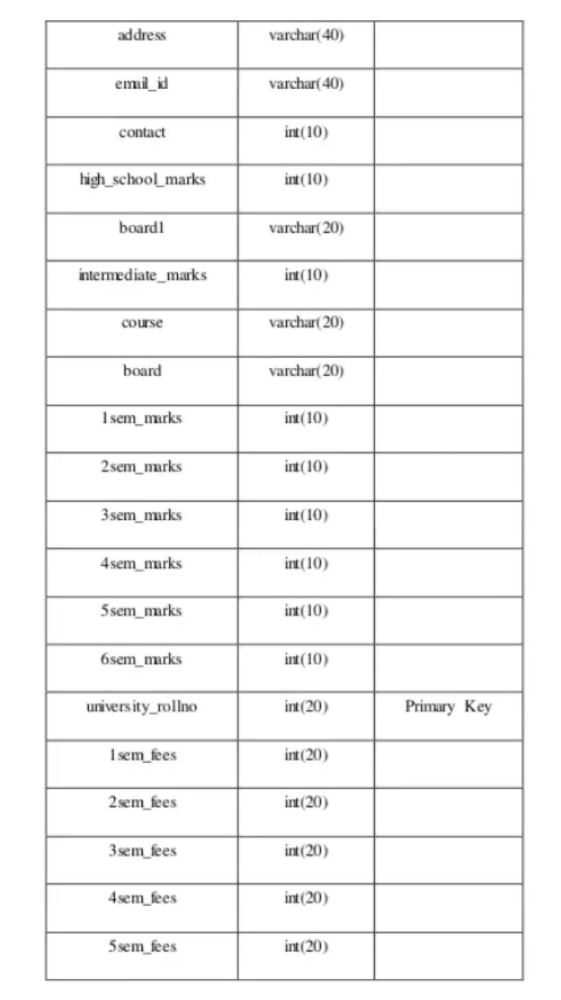

Slide 6
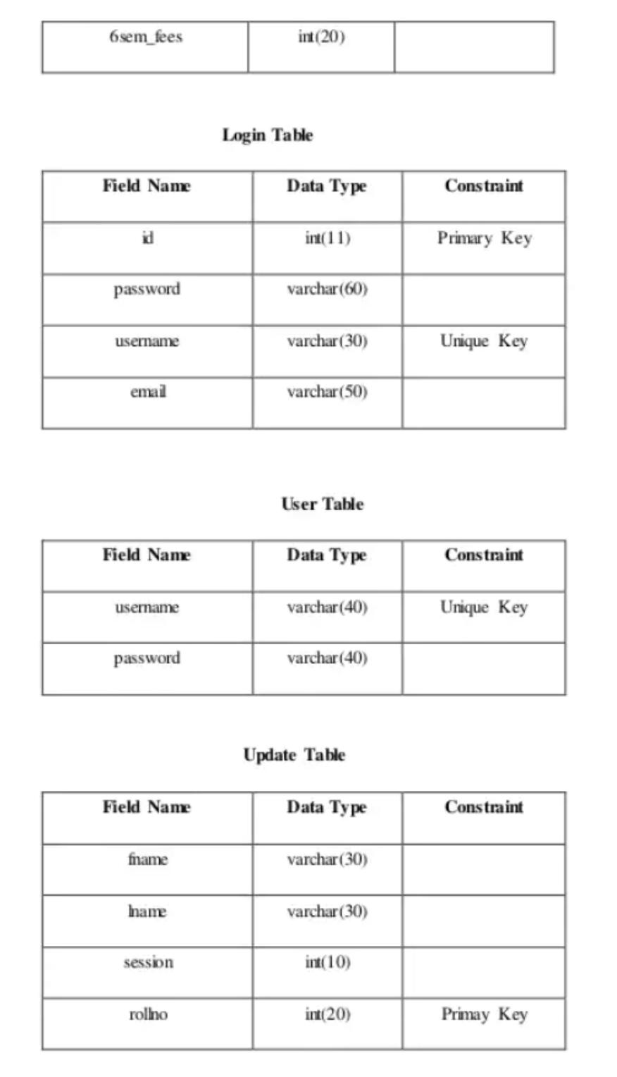

Slide 7
